Slide 1
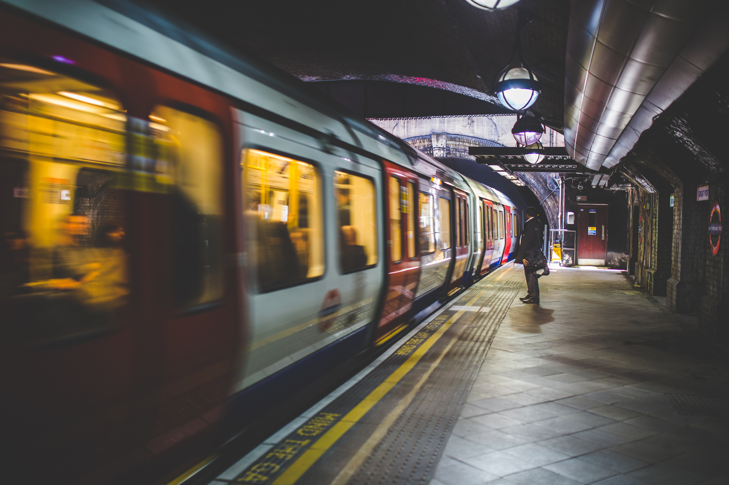
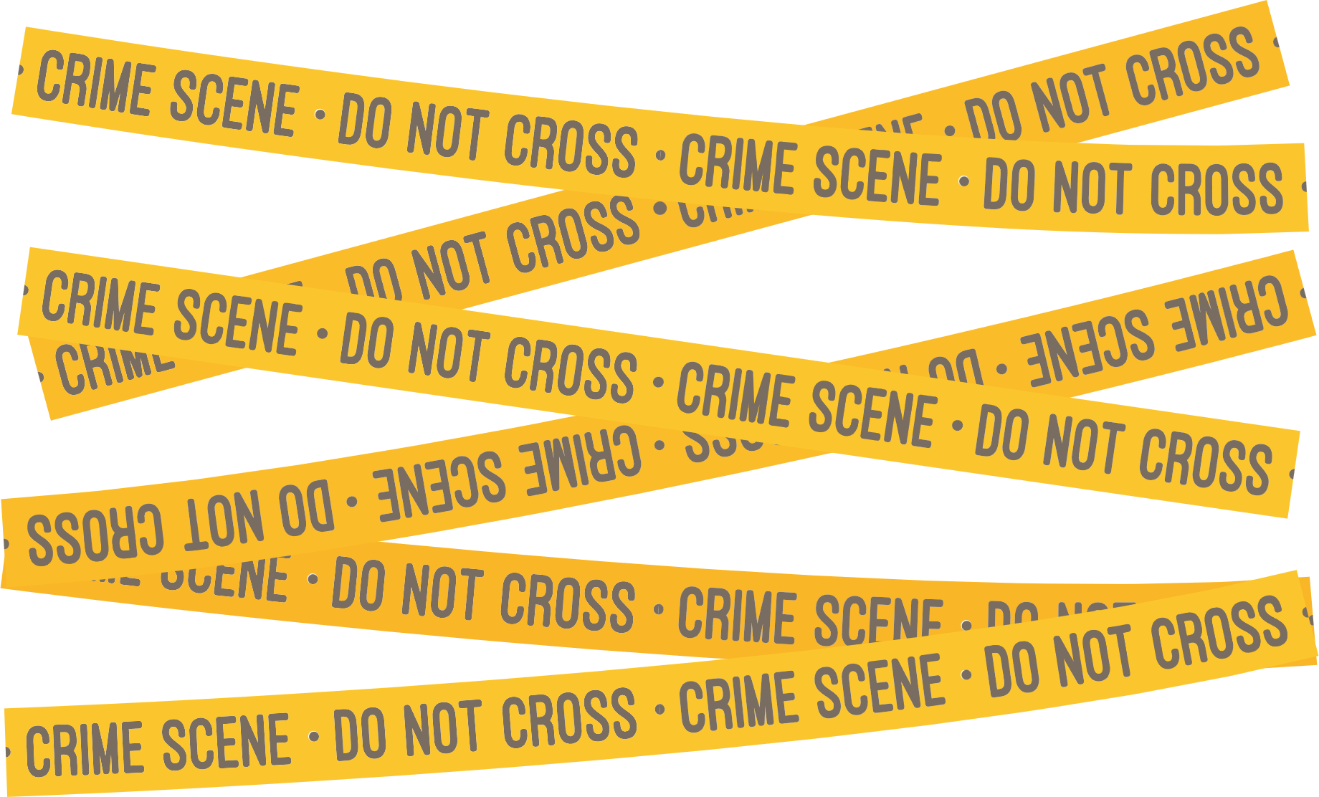
Secret of NIMBY
Analysis of Atlanta Crimes in Relation to the Location of MARTA Rail Stations (2022)
Created by
Park, Meeyoung
Marshall, Ryan
Bhimavarapu, Lakshmi
Bergman, Annalyse
Lu, Yi

Slide 2
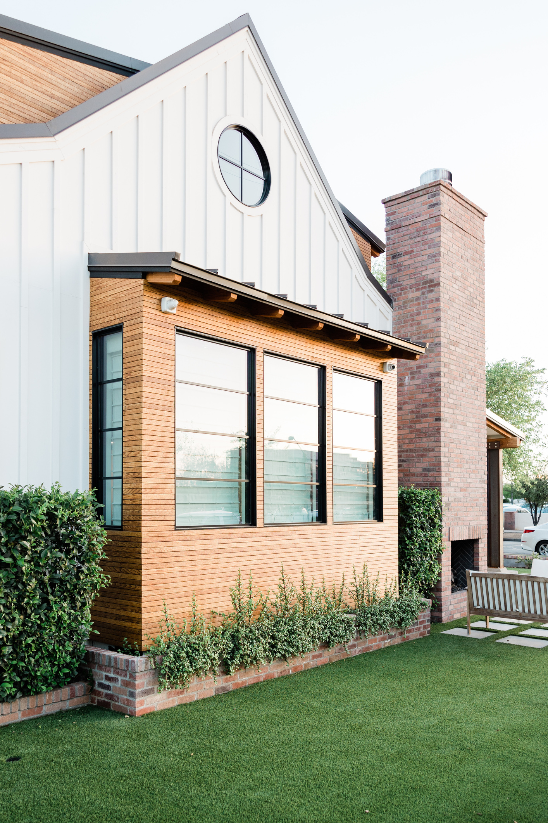


WHAT IS
NIMBY?
An acronym for "Not In My Backyard," describes the phenomenon in which residents of a neighbourhood designate a new development (e.g. shelter, public transportation , group home) as inappropriate or unwanted for their local area.

Slide 3
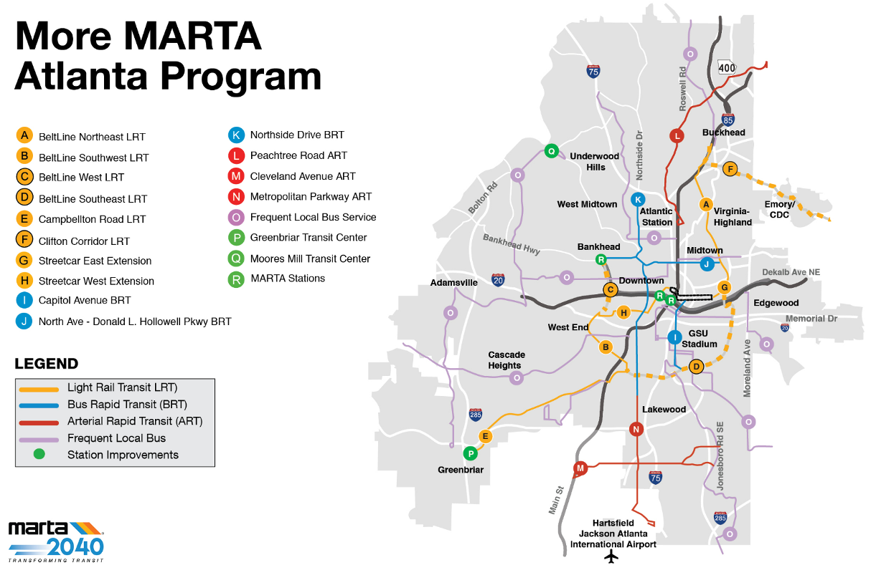
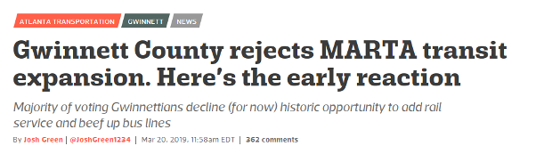
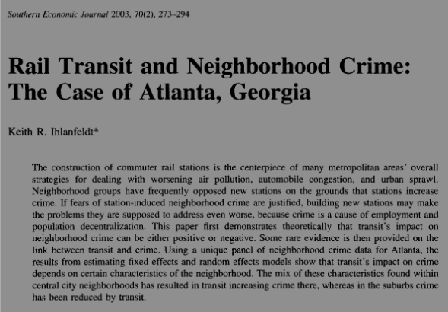

Slide 4













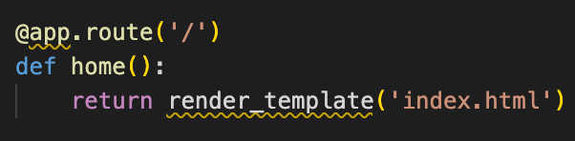
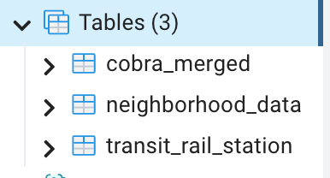

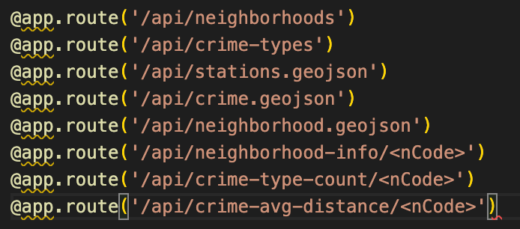

Coding Approach
Data Source
static
Atlanta Police Dept crime database (2022) (csv)
MARTA map (csv)
Atlanta neighborhood info (geojson)
Atlanta neighborhood demographics (2020) (csv)
Data:
geojson
files
Extract
Web
Geojson:
Crimes,Station
Load
Transform
API

Slide 5
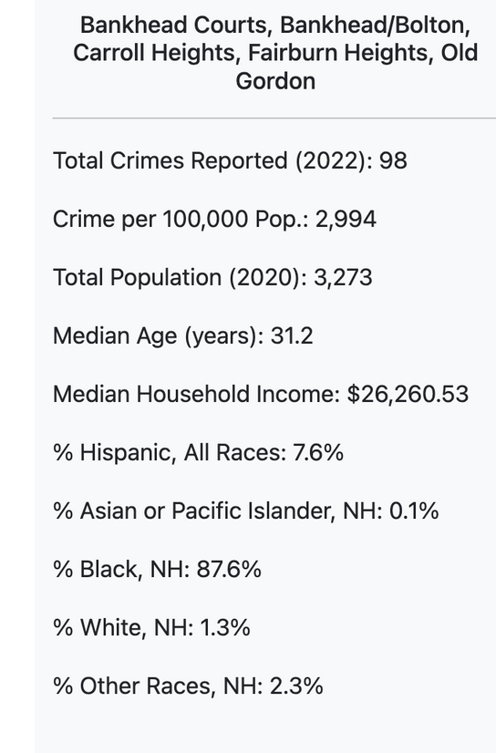
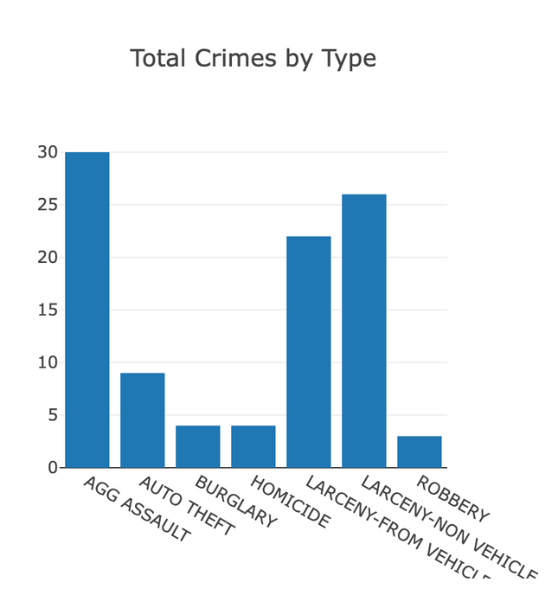
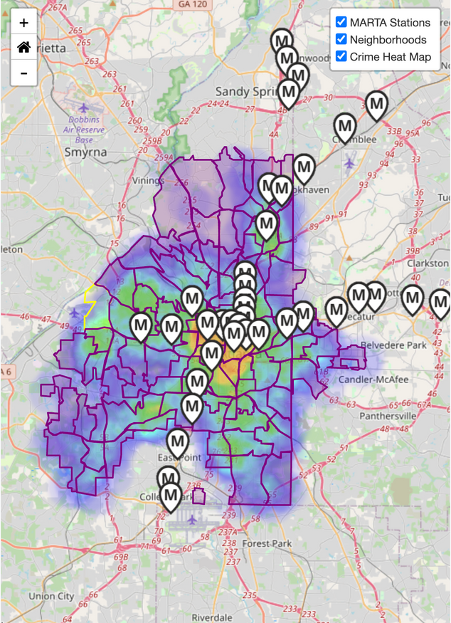
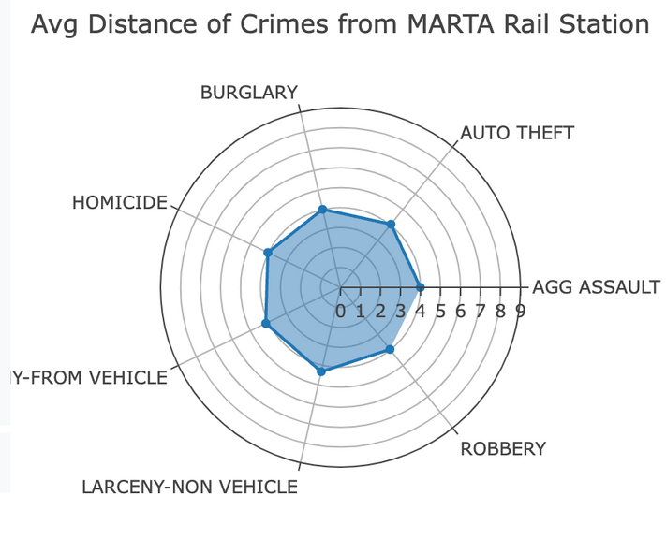
Visualization
NEIGHBORHOOD AND CRIME INFOBOX
HEATMAP
BAR CHART
RADAR CHART

Slide 6
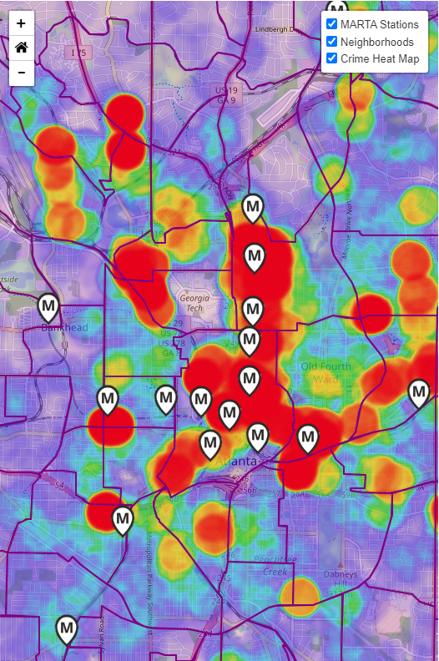
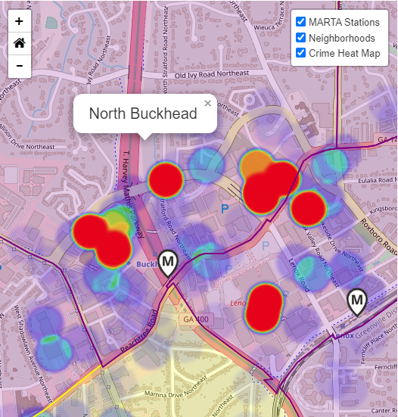
Proximity of Crimes and MARTA Rail Stations, 2022
CONCLUSION
Some correlation between the location of MARTA stations and crimes reported in Atlanta in 2022.
DISCUSSION
Weigh vs potential benefits: traffic, environmental, health, and other societal factors
Need to corroborate findings from other cities with rail stations
Other confounding factors:
Proximity to high-traffic locations (e.g. shopping malls).
Location of MARTA rail stations in urban vs rural/suburban neighborhoods
Level of security measures nearby MARTA rail stations
Notes:
## Conclusions
* There appears to be some correlation between the location of MARTA stations and crimes reported in Atlanta in 2022.
![crimes near stations](static/img/crimes-near-stations.png)
Discussion
* Need to weigh an increase in crimes against a potential benefit in traffic, environmental, health, and other societal factors
* A similar analysis would need to be conducted in other cities to corroborate findings
* Other confounding factors may affect the level of crime near MARTA stations:
* Proximity to high-traffic locations such as shopping malls. For instance, in Buckhead, we can see that crimes are densely centered at the location of shopping malls and retail districts.
![Buckhead](static/img/buckhead.png)
* Location of MARTA rail stations in urban vs rural/suburban neighborhoods
* Level of security measures nearby MARTA rail stations in place to reduce crimes

